Slide 1
Static Electricity

Slide 2
Learning Intention
We are learning about static electricity.
Success Criteria
Students will be able to:
State what static electricity is.
Describe how static electricity is produced.
Apply knowledge of static electricity to its uses.

Slide 3

Do Now: Keyword Match
Match the definitions to the keywords:
a. The rate of flow of charge around a circuit.
1. voltage
b. Measure of how easy it is for the current to flow around a circuit.
2. current
3. resistance
c. The invisible magnetic force between the magnets
will pull the poles together.
4. attract
d. The strength of the push provided to electrons by the battery in a circuit
5. repel
e. The invisible magnetic force between the magnets will force the poles away from each other.
You have 2 minutes.

Slide 4

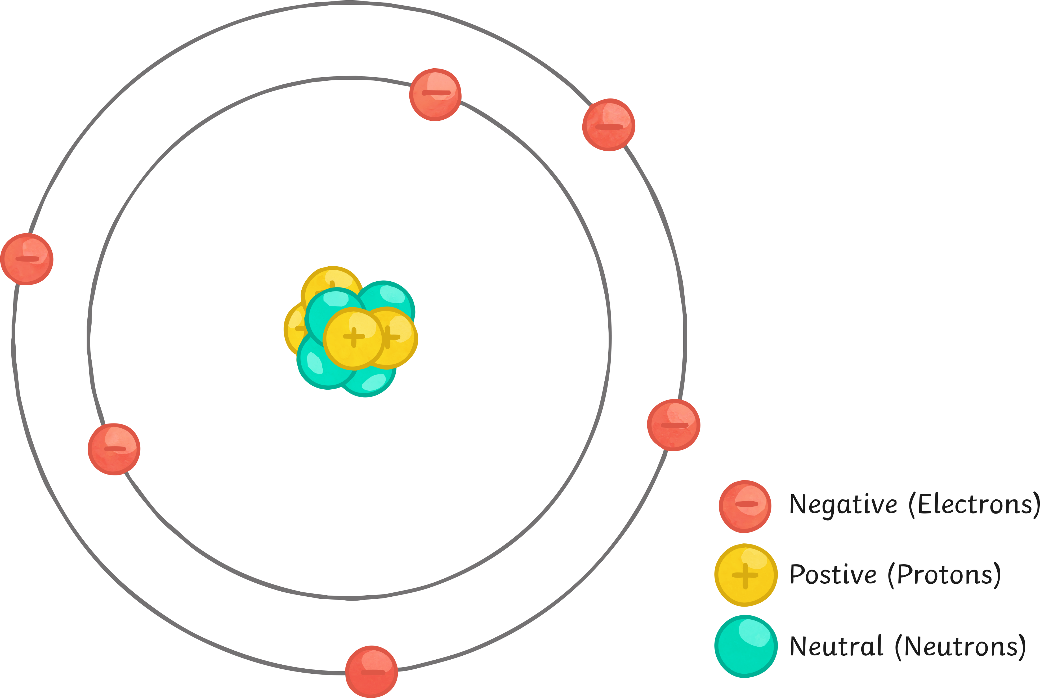
The Atom
There are two kinds of charge: positive (+) and negative (-).
All objects are made up of atoms. Each atom contains three different types of particle.
A positive particle (proton), a negative particle (electron) and a particle with no charge (neutron).
Atoms contain the same number of protons and electrons. The positive and negative charges are cancelled out and so an atom has no overall charge.

Slide 5
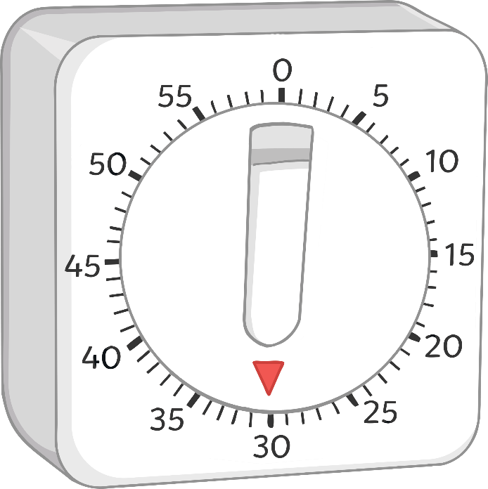
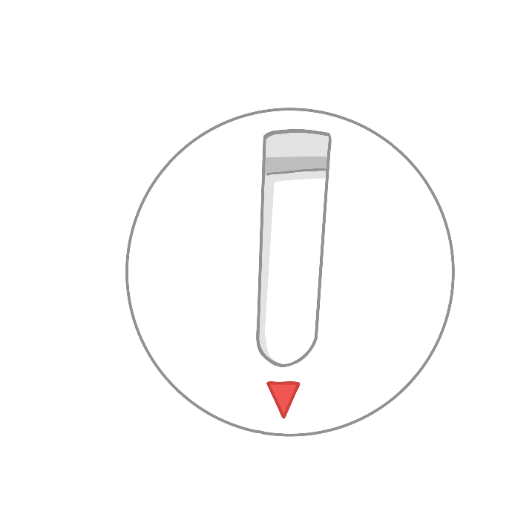
The Atom
Static electricity occurs when an object either loses or gains a negative charge.
We say that objects that lose negative charges become positively (+) charged overall.
We say that objects that gain negative charges become negatively (-) charged overall.
Using your worksheet, you have one minute to draw and label an atom.
Start

Slide 6

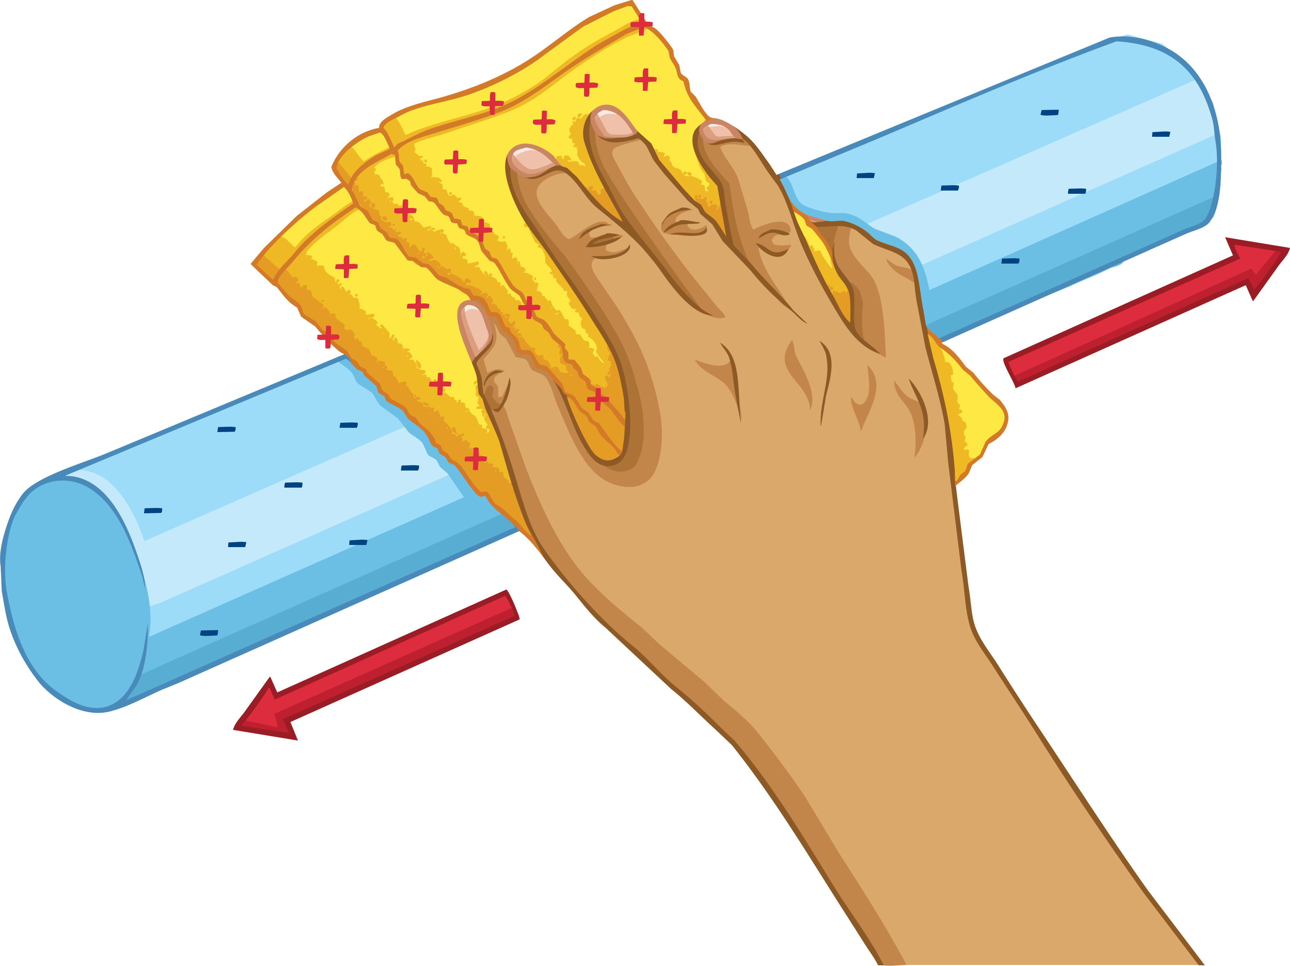
What Is Static Electricity?
With your partner, can you think of any situations where you have felt a static shock?
When a polythene strip is rubbed with a cloth, the negative charges move from the cloth to the strip.
The strip becomes negatively charged because it has more negative charges than it needs to cancel out the positive charges.
The cloth becomes positive because it has less negative charges than it needs.

Slide 7
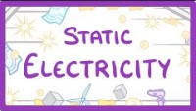
What Is Static Electricity?

Slide 8
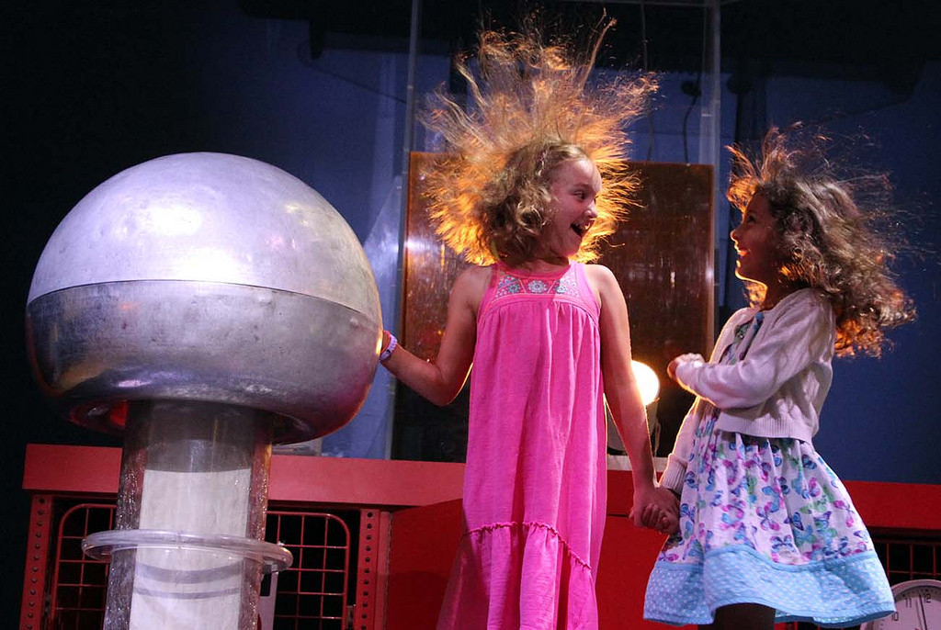
Van de Graaff Generator
In 1931, Robert J Van de Graaff invented the Van de Graaff generator. He invented it for the sole purpose of generating high voltages for use in nuclear physics experiments.
Photo courtesy of uclmaps (@flickr.com) - granted under creative commons licence – attribution

Slide 9

Van de Graaff Generator
are transferred onto the dome so the dome gets an electrical charge.
When we touch the dome, the charge is passed to us.
We have to stand in a plastic tray. This is because plastic is an so the electrical charge cannot flow through our bodies and feet to earth.
Our hair stands up because each strand is negatively charged and the same charges .
When the electrical charge jumps between the two domes, it makes a . This can light a gas such as methane.
Electrons
electrical
insulator
repel
spark
flammable
Use the words in the box to help you fill in the gaps:
electrical, electrons, flammable, insulator, spark, repel.

Slide 10
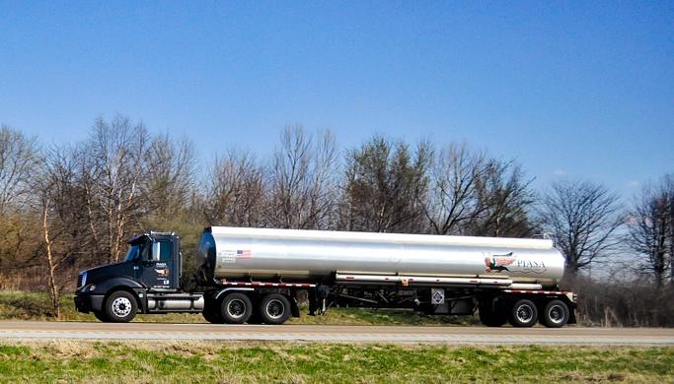
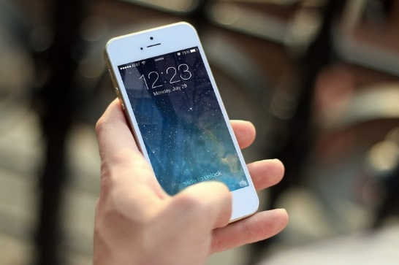
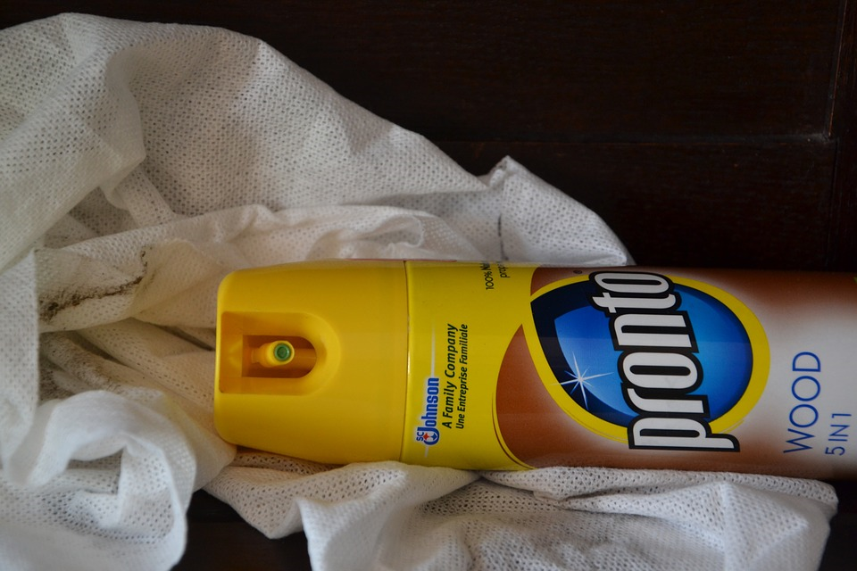

Dangers of Static Electricity
Using the picture clues, how could static electricity be dangerous or a nuisance?
Petrol tankers travelling on the roads.
Using a mobile phone on a petrol station forecourt.
Cleaning an oil tanker.
Dust attracted to insulators, for example the TV screen.
Clothes made from synthetic materials cling to each other.

Slide 11

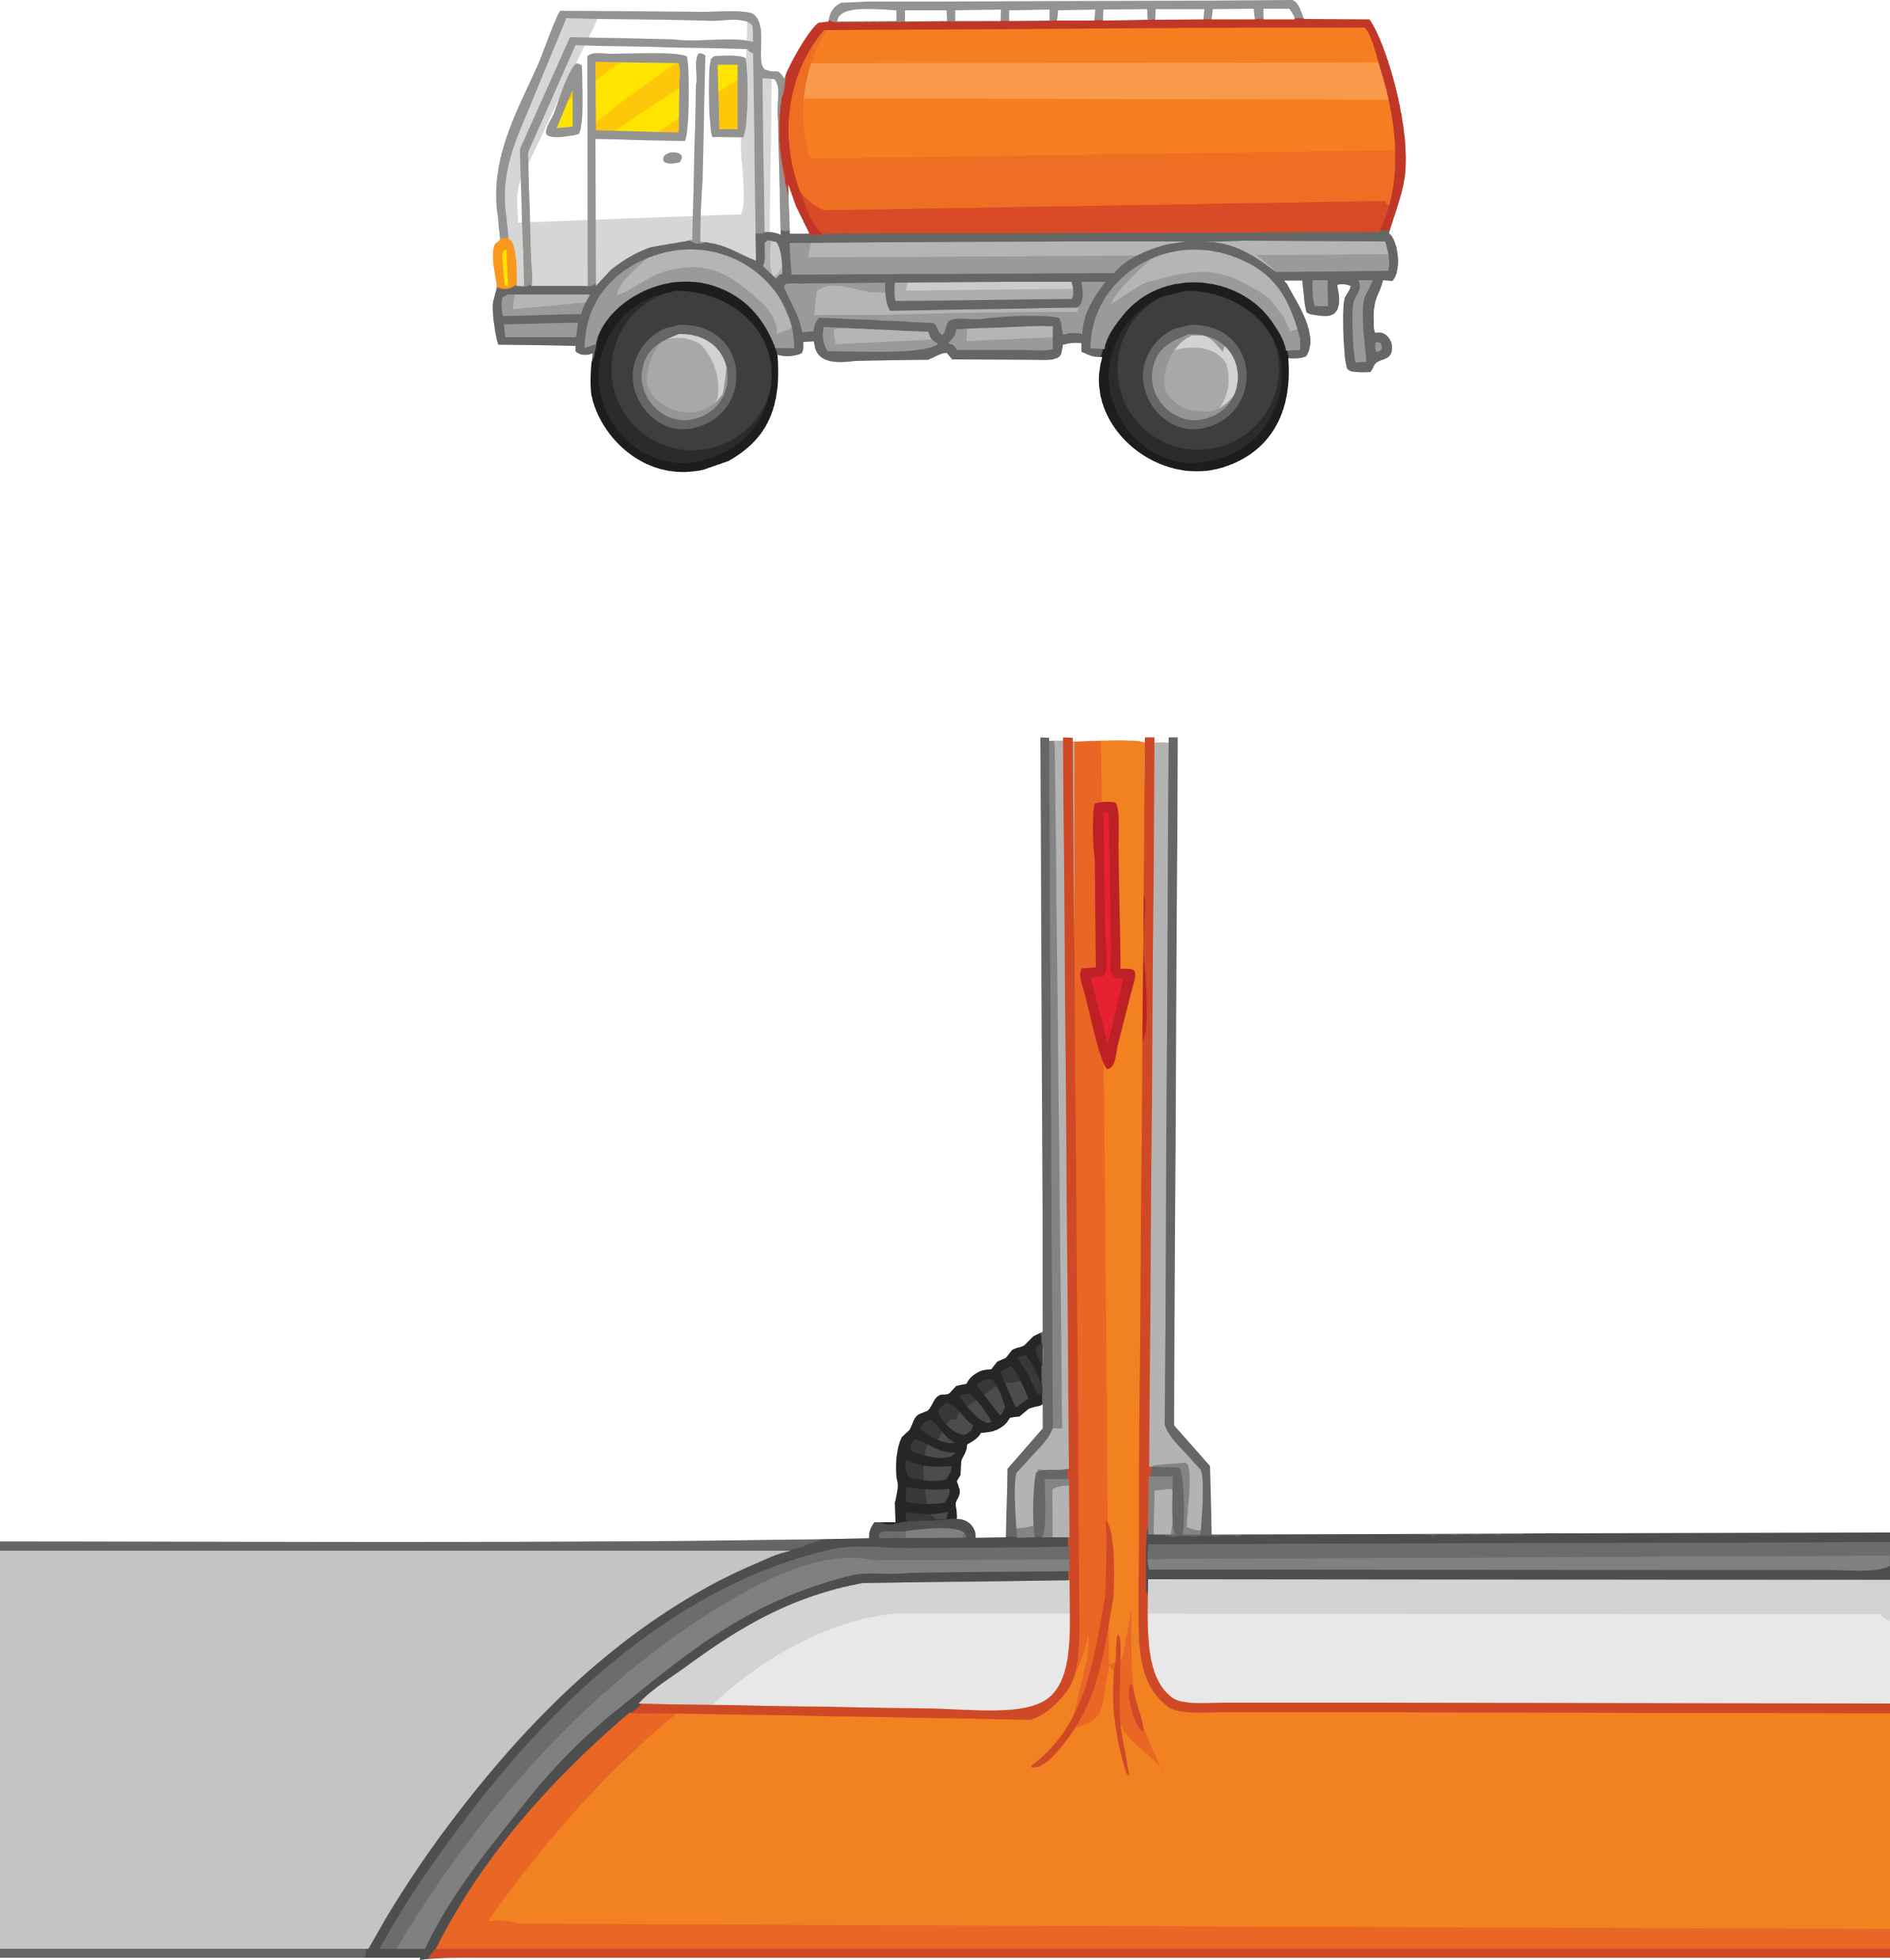
Dangers of Static Electricity
So what can we do to prevent explosions due to electrostatic sparks?
You could use anti-static devices such as liquids and dusters which carry away the electrical charges that build up.
In oil tankers, inert gases such as nitrogen are injected into the tank whilst cleaning out oil tankers to stop a spark igniting the contents of the tanker.
a static charge can build up in the pipe as the petrol flows through it
the metal tank is connected to the Earth
Underground tank at a petrol station

Slide 12
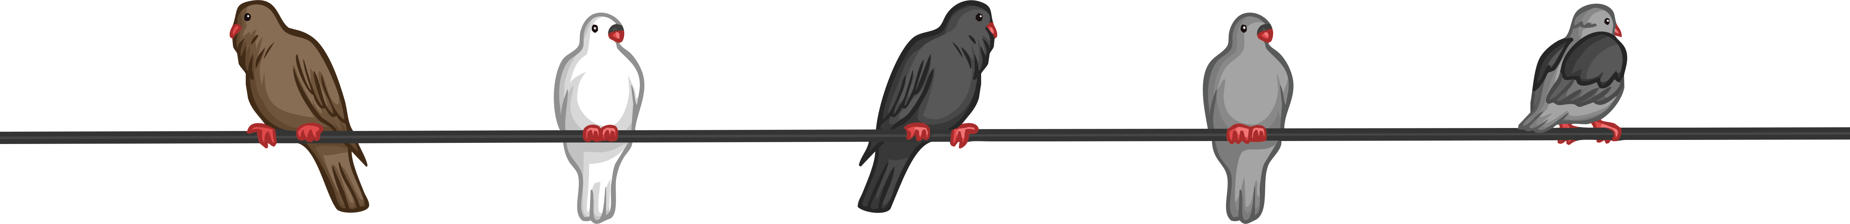

Dangers of Static Electricity
Using the picture above to help you, answer the following question. Use the keywords to support your answer.
Why don’t birds get an electric shock when they sit on the overhead cables?
The birds are not earthed as they are not touching the ground. The voltage is the same all the way across. If the bird was to put a toe on the ground, then the current would travel through them to the earth.
You have 3 minutes.
Key Terms
voltage current earth

Slide 13
Plenary: Static Quiz
Produced by friction. | There are two types of charges. | The charge on an electron.
Like charges will do this. | Opposite charges will do this. | Photocopiers use this.
To prevent explosions due to electrostatic sparks, we could use… | What are atoms that have lost electrons called? | A rod which loses electrons will have which charge?
What are objects that are able to carry an electrical charge called? | What are objects that are not able to carry an electrical charge called? | A cloth which gains electrons will have which charge?
1
2
3
static electricity
positive and negative
negative
4
5
6
repel
attract
static electricity
7
8
9
anti-static devices such as liquids and dusters.
ions
positive
10
11
12
conductors
insulators
negative

